Slide 1
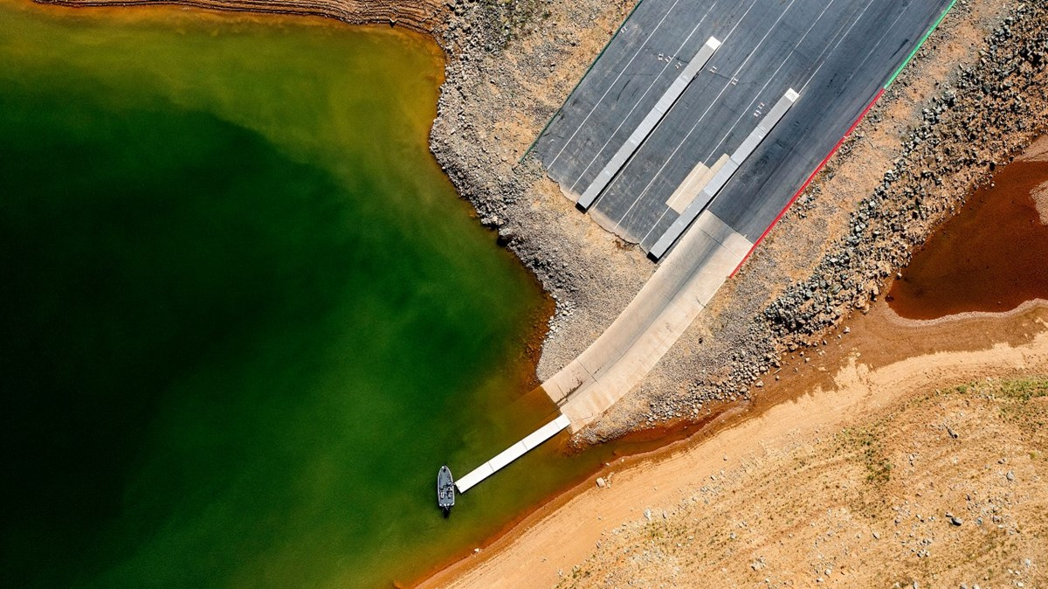
H51I - Water and Society: Water Resources Management and Policy in a Changing World (AGU 2024)
Stress Testing California's Water System using an Exploratory Ensemble Analysis Conditioned on the Late Renaissance Megadrought and Climate Change
AUTHORS
Rohini S. Gupta^{1*}, Scott Steinschneider¹, Harrison B. Zeff² , Patrick M. Reed³
¹Biological and Environmental Engineering, Cornell University
² University of North Carolina at Chapel Hill
³Civil and Environmental Engineering, Cornell University
*Presenting author: rg727@cornell.edu
Lake Oroville, May 2021 (source: Noah Berger / AP photo)

Slide 2
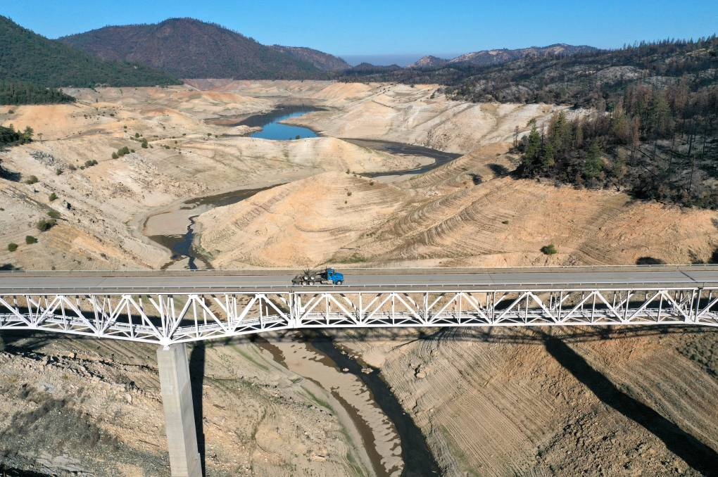
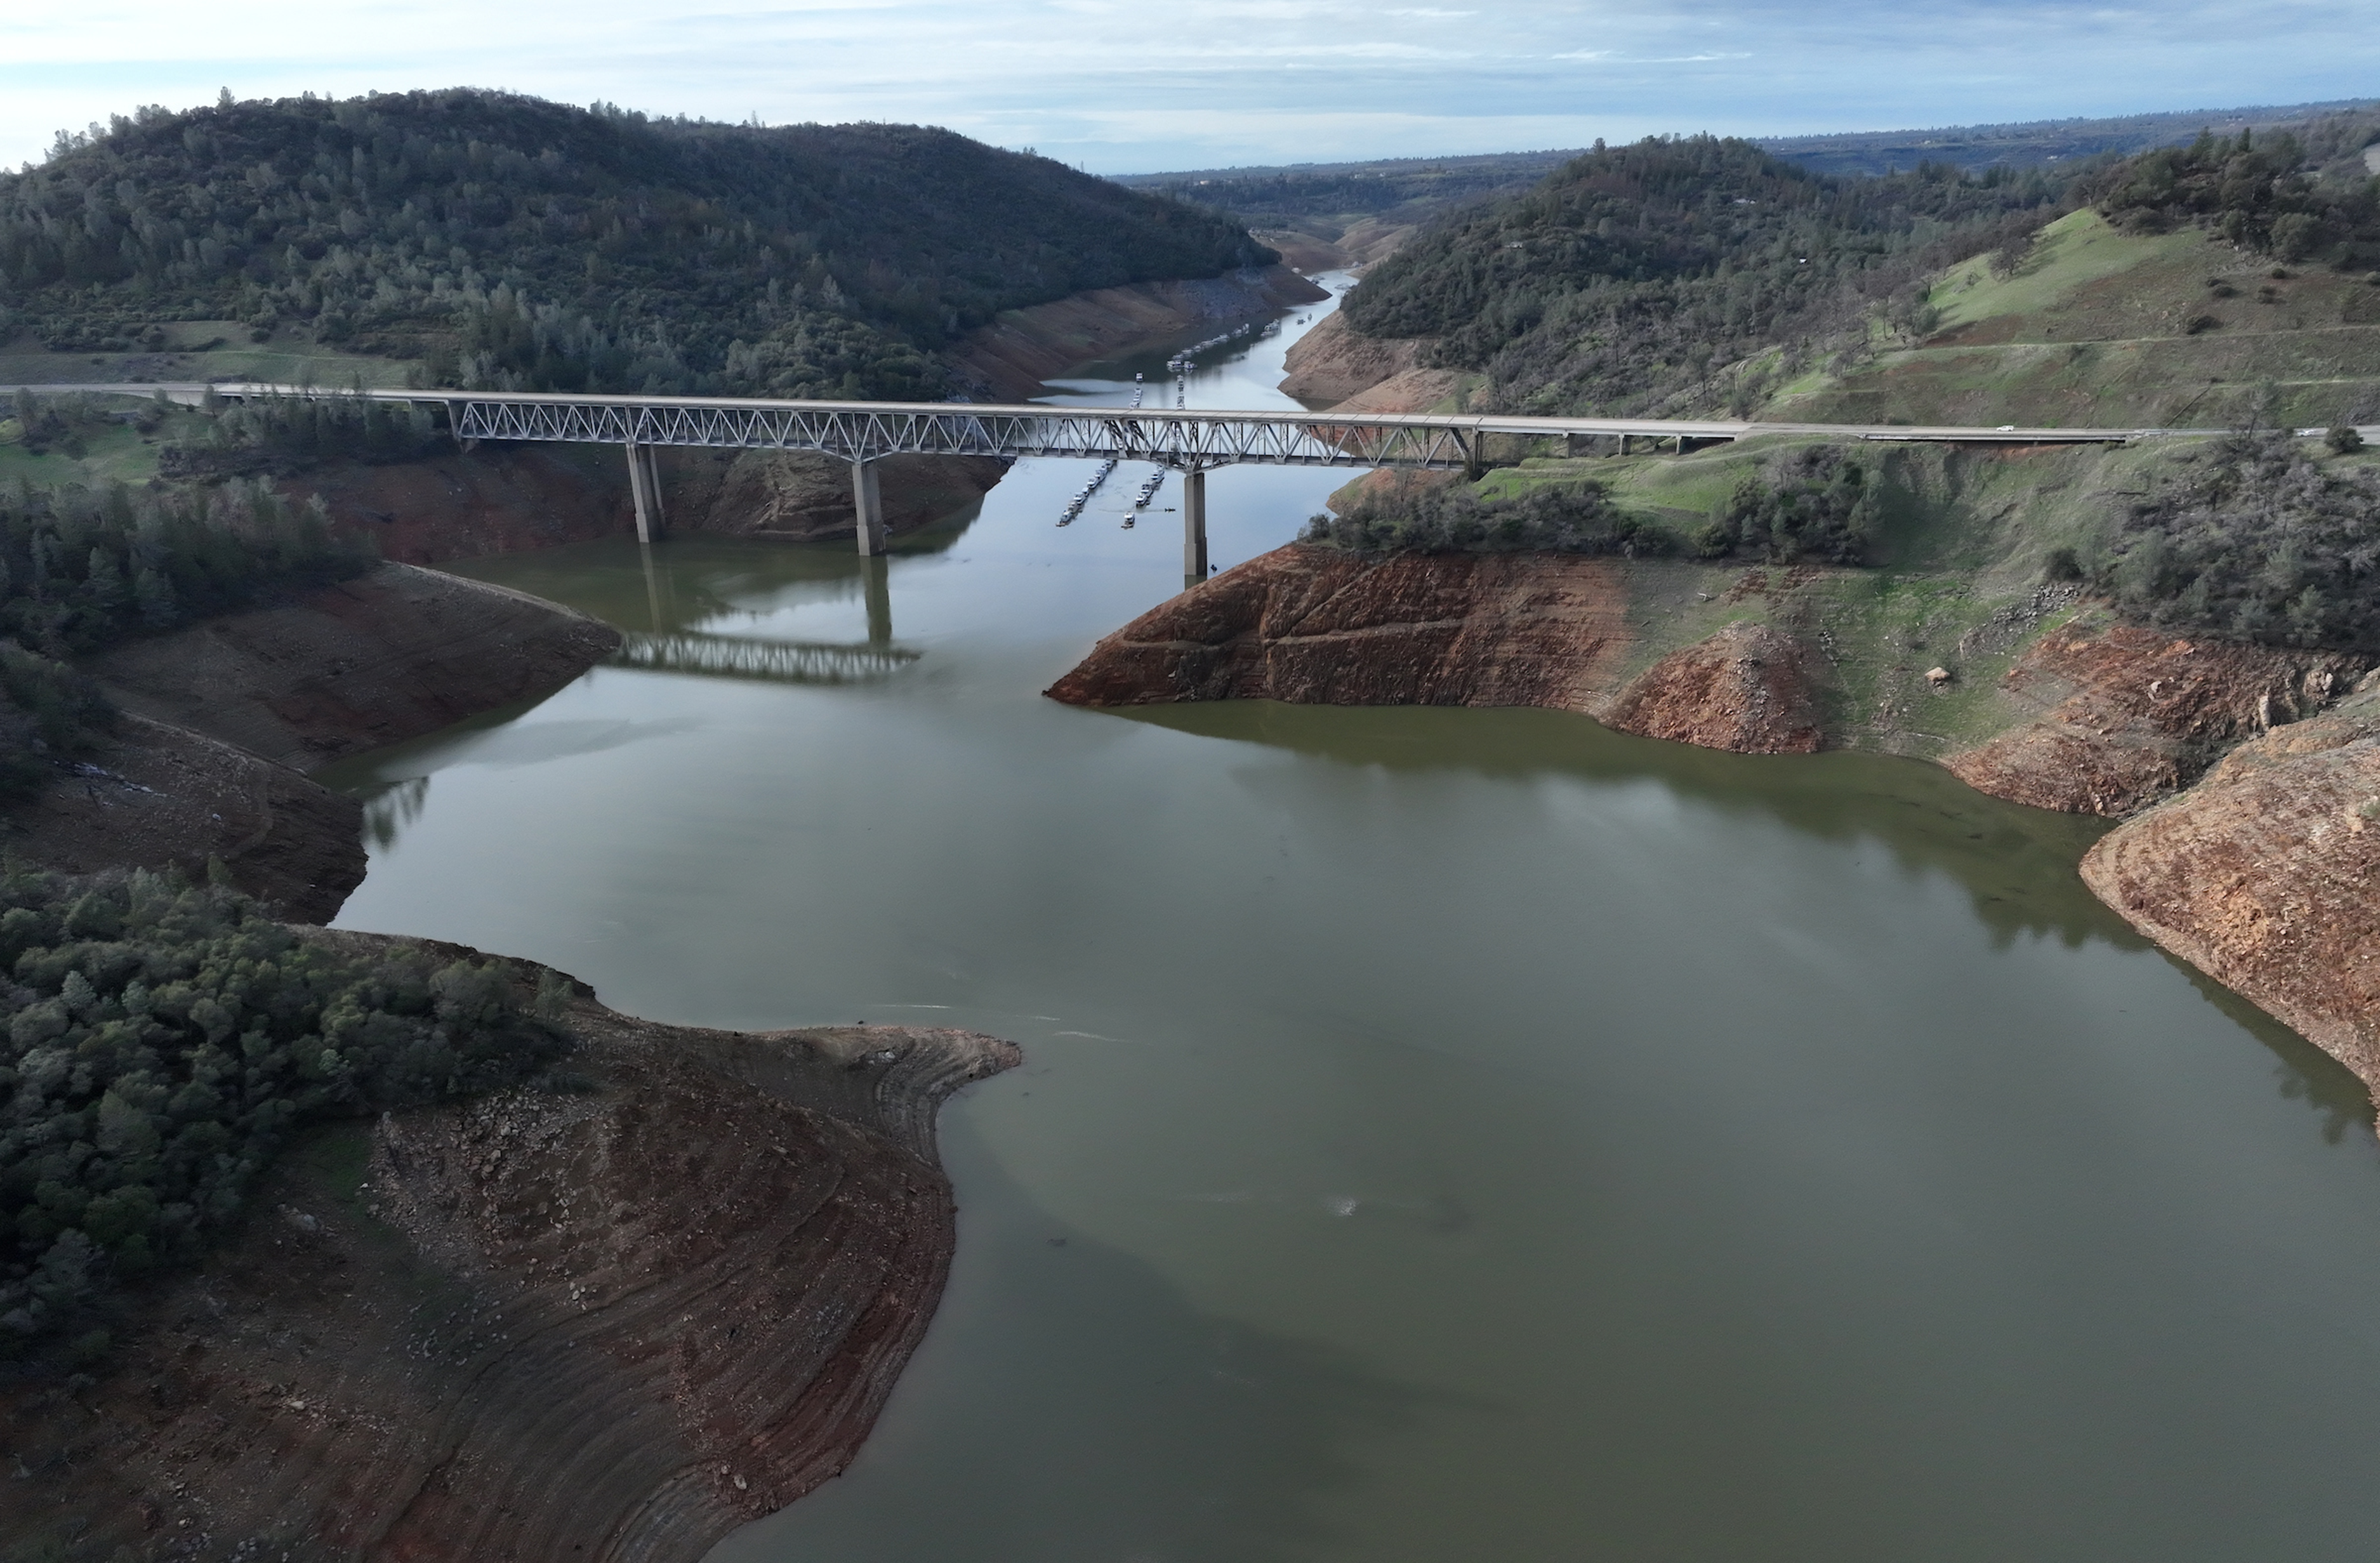
Introduction | Methods | Results | Conclusions
California experiences extreme hydroclimate volatility that poses challenges for the region’s water system planning and management.
2021
Lake Oroville
2023
Source: Justin Sullivan/Getty Images
Source: CA DWR

Slide 3
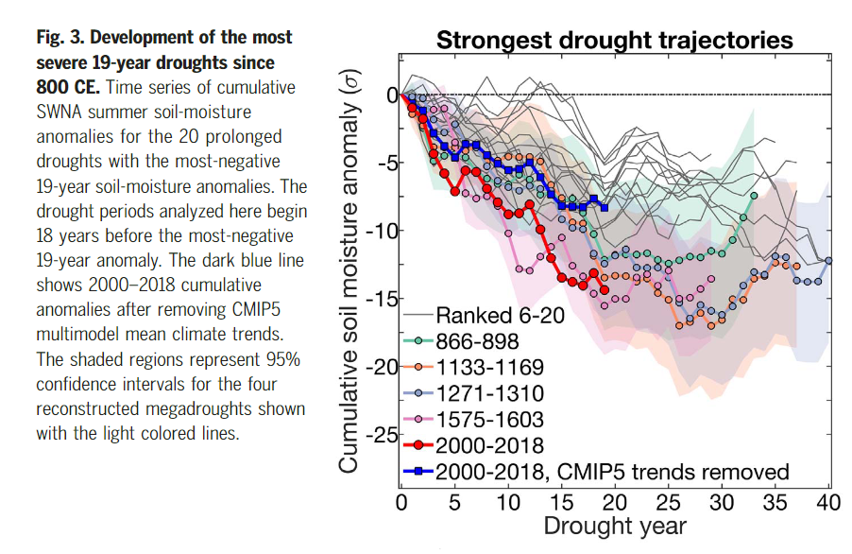
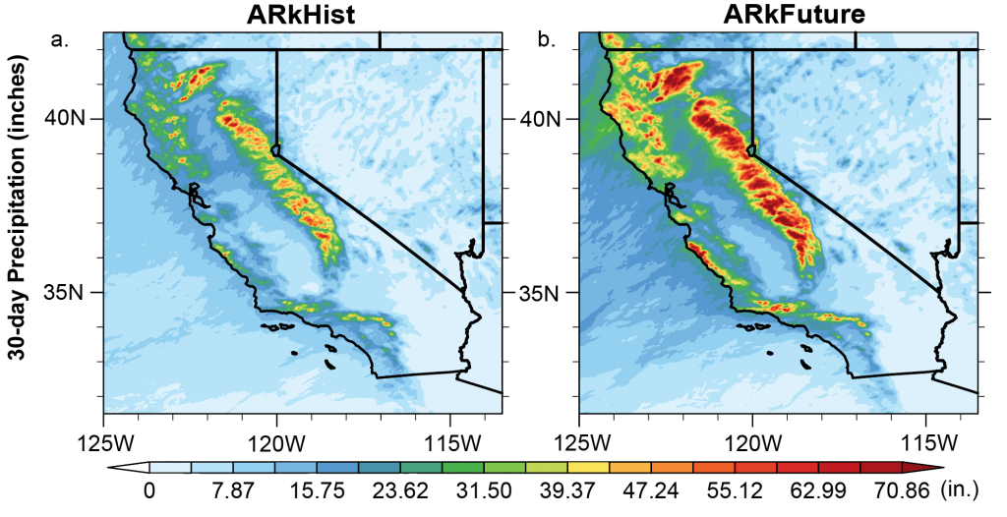
Introduction | Methods | Results | Conclusions
California’s cycles of flood and drought are intensifying under climate change.

Slide 4
Introduction | Methods | Results | Conclusions
California’s cycles of flood and drought are intensifying under climate change, but impacts are hard to predict.
Extremes result from co-evolution of climate change with natural variability.
1

Slide 5
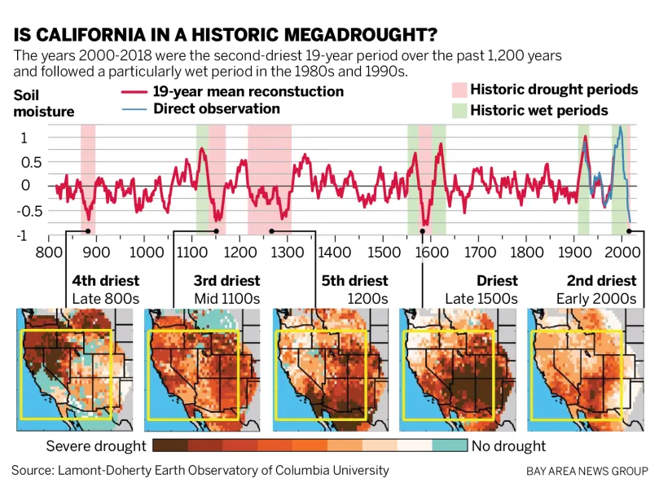
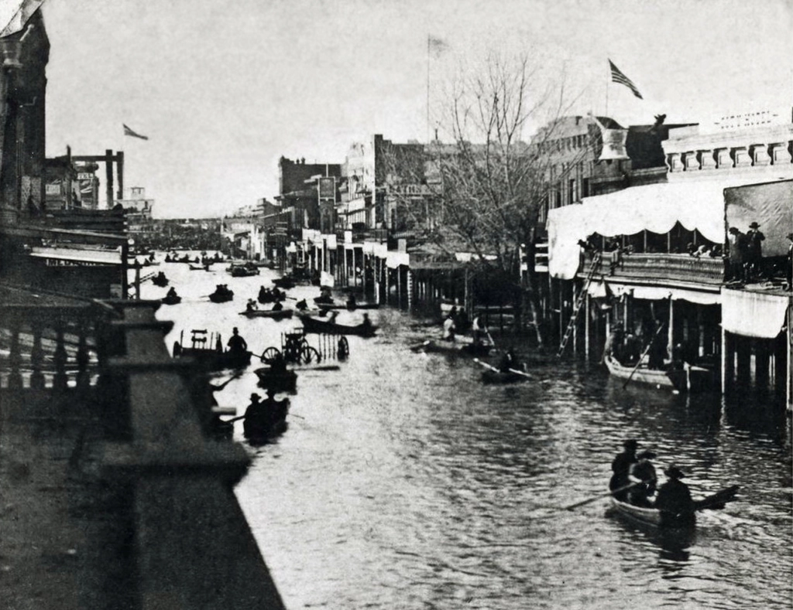
Introduction | Methods | Results | Conclusions
California’s cycles of flood and drought are intensifying under climate change, but impacts are hard to predict.
Extremes result from co-evolution of climate change with natural variability.
1
California has experienced megadroughts and megaflood events in absence of human activity.
The Great Flood of 1862
Source: San Bernadino Sun

Slide 6
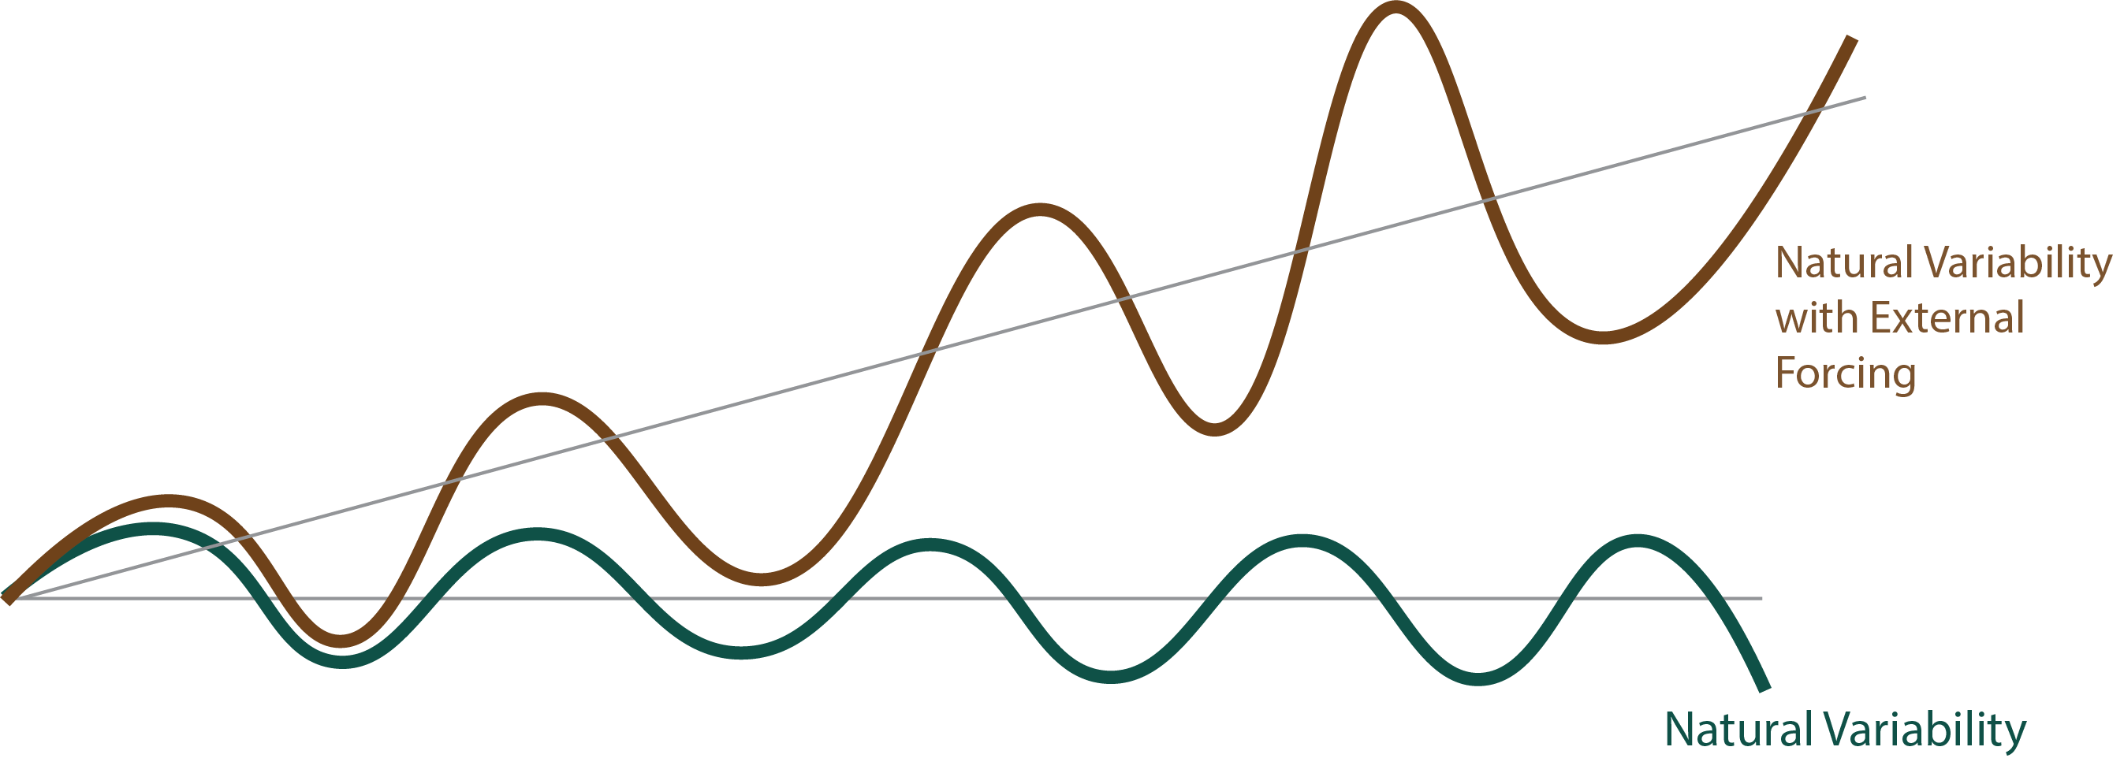
Introduction | Methods | Results | Conclusions
California’s cycles of flood and drought are intensifying under climate change, but impacts are hard to predict.
Extremes result from co-evolution of climate change with natural variability.
1
Extremes can be amplified due to external forcings like human-driven warming.

Slide 7
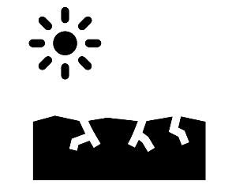
Introduction | Methods | Results | Conclusions
California’s cycles of flood and drought are intensifying under climate change, but impacts are hard to predict.
2
Vulnerabilities to users are shaped by how extremes will propagate through California’s complex water system.
Hydroclimate Extremes
v

Slide 8
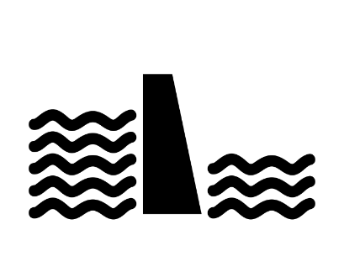
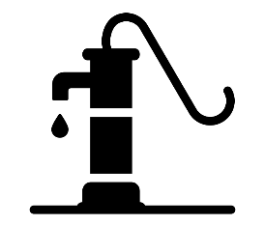
Introduction | Methods | Results | Conclusions
California’s cycles of flood and drought are intensifying under climate change, but impacts are hard to predict.
2
Vulnerabilities to users are shaped by how extremes will propagate through California’s complex water system.
Current policy, operating rules
Hydroclimate Extremes
v
v
Groundwater/ Reservoir Storage States
v

Slide 9
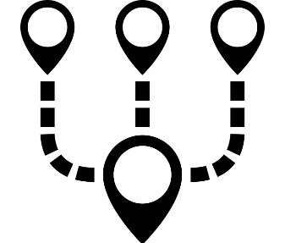
Introduction | Methods | Results | Conclusions
California’s cycles of flood and drought are intensifying under climate change, but impacts are hard to predict.
2
Vulnerabilities to users are shaped by how extremes will propagate through California’s complex water system.
Current policy, operating rules
Hydroclimate Extremes
v
v
Groundwater/ Reservoir Storage States
v
Diversity of Water Sources
Water Rights

Slide 10
Introduction | Methods | Results | Conclusions
Motivating Question
How can we comprehensively map the impacts of hydroclimate extremes through the state’s institutionally complex water system and down to its diverse users?

Slide 11
Introduction | Methods | Results | Conclusions
Motivating Question
How can we comprehensively map the impacts of hydroclimate extremes through the state’s institutionally complex water system and down to its diverse users?
Comprehensively understanding a user’s risk requires exploring the range of vulnerabilities that manifest under many different scenarios.

Slide 12
Introduction | Methods | Results | Conclusions
Motivating Question
We create an exploratory modeling framework that combines
A highly resolved model of California’s water system
A large ensemble of consequential hydrology.
How can we comprehensively map the impacts of hydroclimate extremes through the state’s institutionally complex water system and down to its diverse users?
Comprehensively understanding a user’s risk requires exploring the range of vulnerabilities that manifest under many different scenarios.

Slide 13
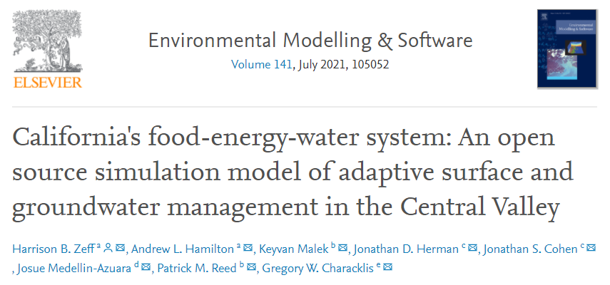
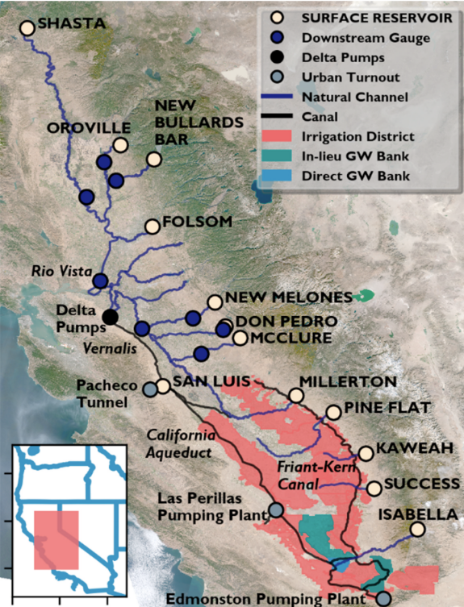
We have a highly resolved simulation model of the CALFEWS system.
Introduction | Methods | Results | Conclusions
Daily timescale operation of >1000 critical institutional and infrastructure elements
(dams, water conveyance systems, groundwater banks, irrigation districts)
https://github.com/hbz5000/CALFEWS

Slide 14
We have a large ensemble of 600-year streamflow traces.
Introduction | Methods | Results | Conclusions
Gupta et al., 2023
*Created from a paleo-conditioned weather generator combined with a hydrologic model

Slide 15
We isolate out a 30-year section of the Late Renaissance Megadrought (1550-1580 CE).
Introduction | Methods | Results | Conclusions
Gupta et al., 2023
Late Renaissance Megadrought

Slide 16
We layer plausible climate changes on top of megadrought-conditioned weather.
Introduction | Methods | Results | Conclusions
We isolate a scenario of 4 degree temperature increase, and 7% scaling of precipitation.

Slide 17
Key Questions
Introduction | Methods | Results | Conclusions
How do drought dynamics uncovered in the Late Renaissance Megadrought propagate through California’s modern water system?
1

Slide 18
Key Questions
Introduction | Methods | Results | Conclusions
How do drought dynamics uncovered in the Late Renaissance Megadrought propagate through California’s modern water system?
1
2
How does risk evolve when megadrought dynamics are embedded with plausible climate change signals?

Slide 19
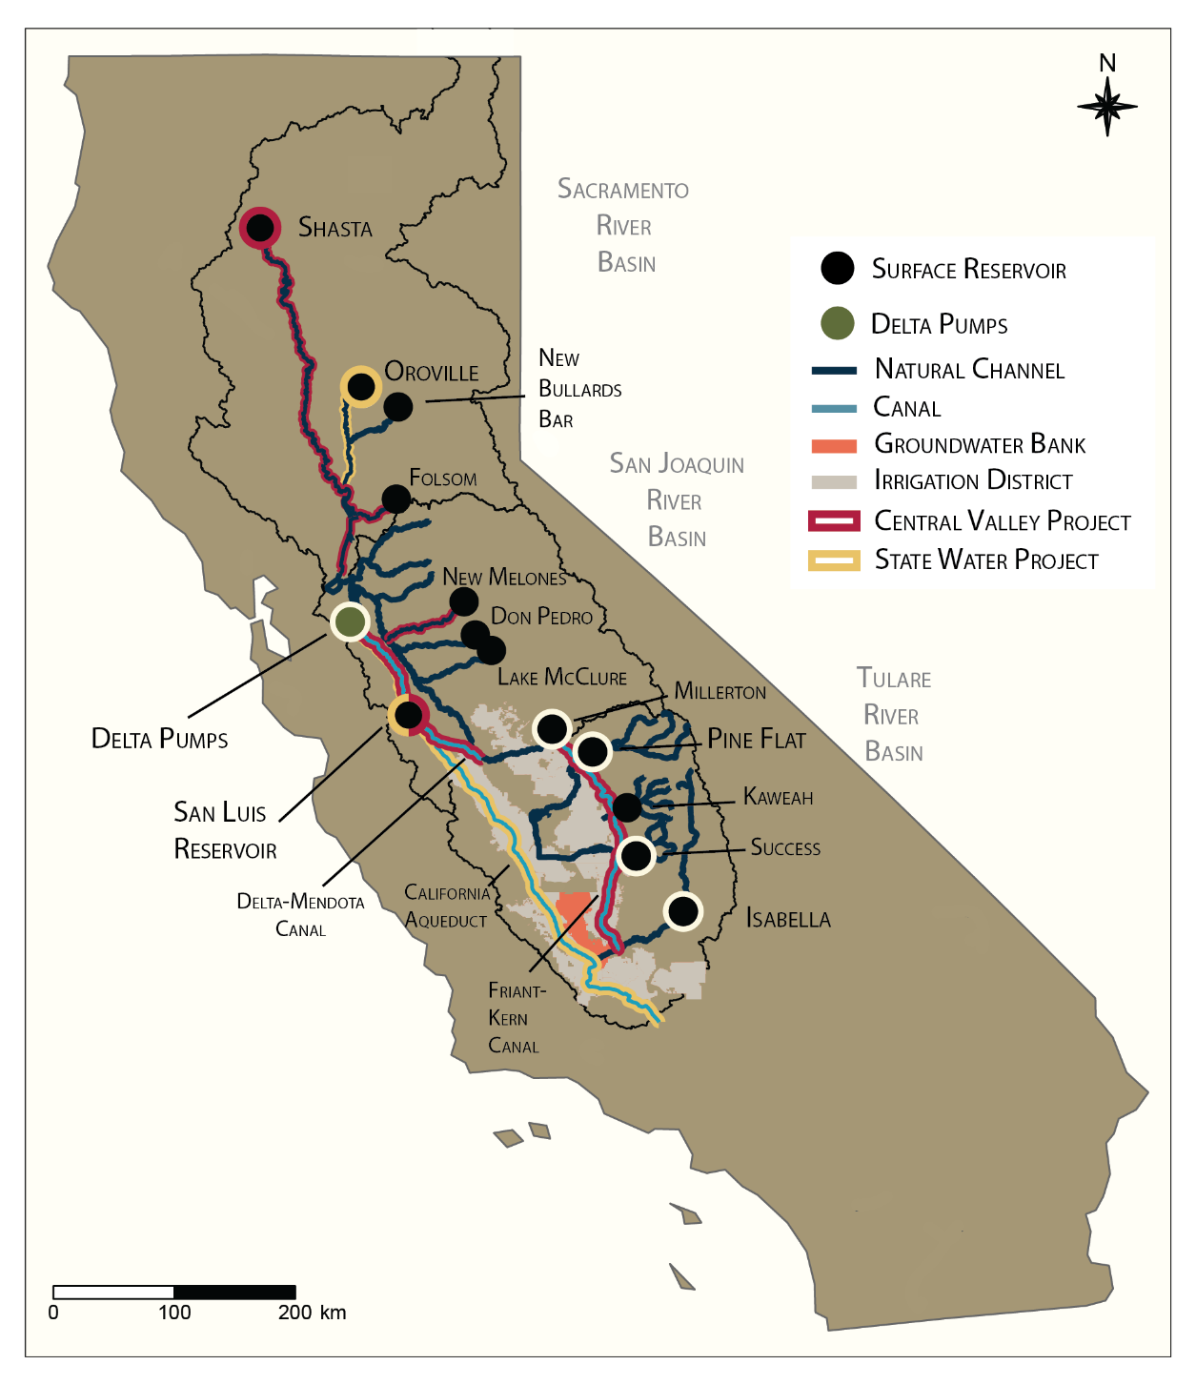
Introduction | Methods | Results | Conclusions

Slide 20
Introduction | Methods | Results | Conclusions
North
Sacramento and San Joaquin River Basins
Water Conveyance
South
Tulare River Basin

Slide 21
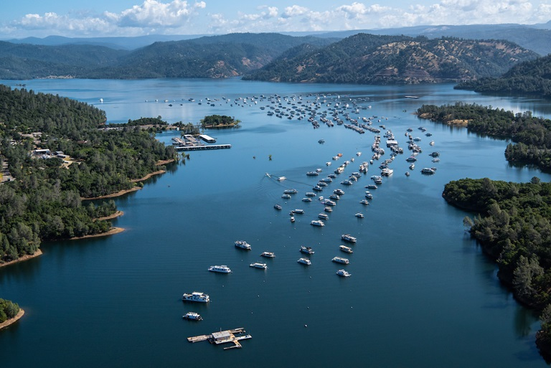
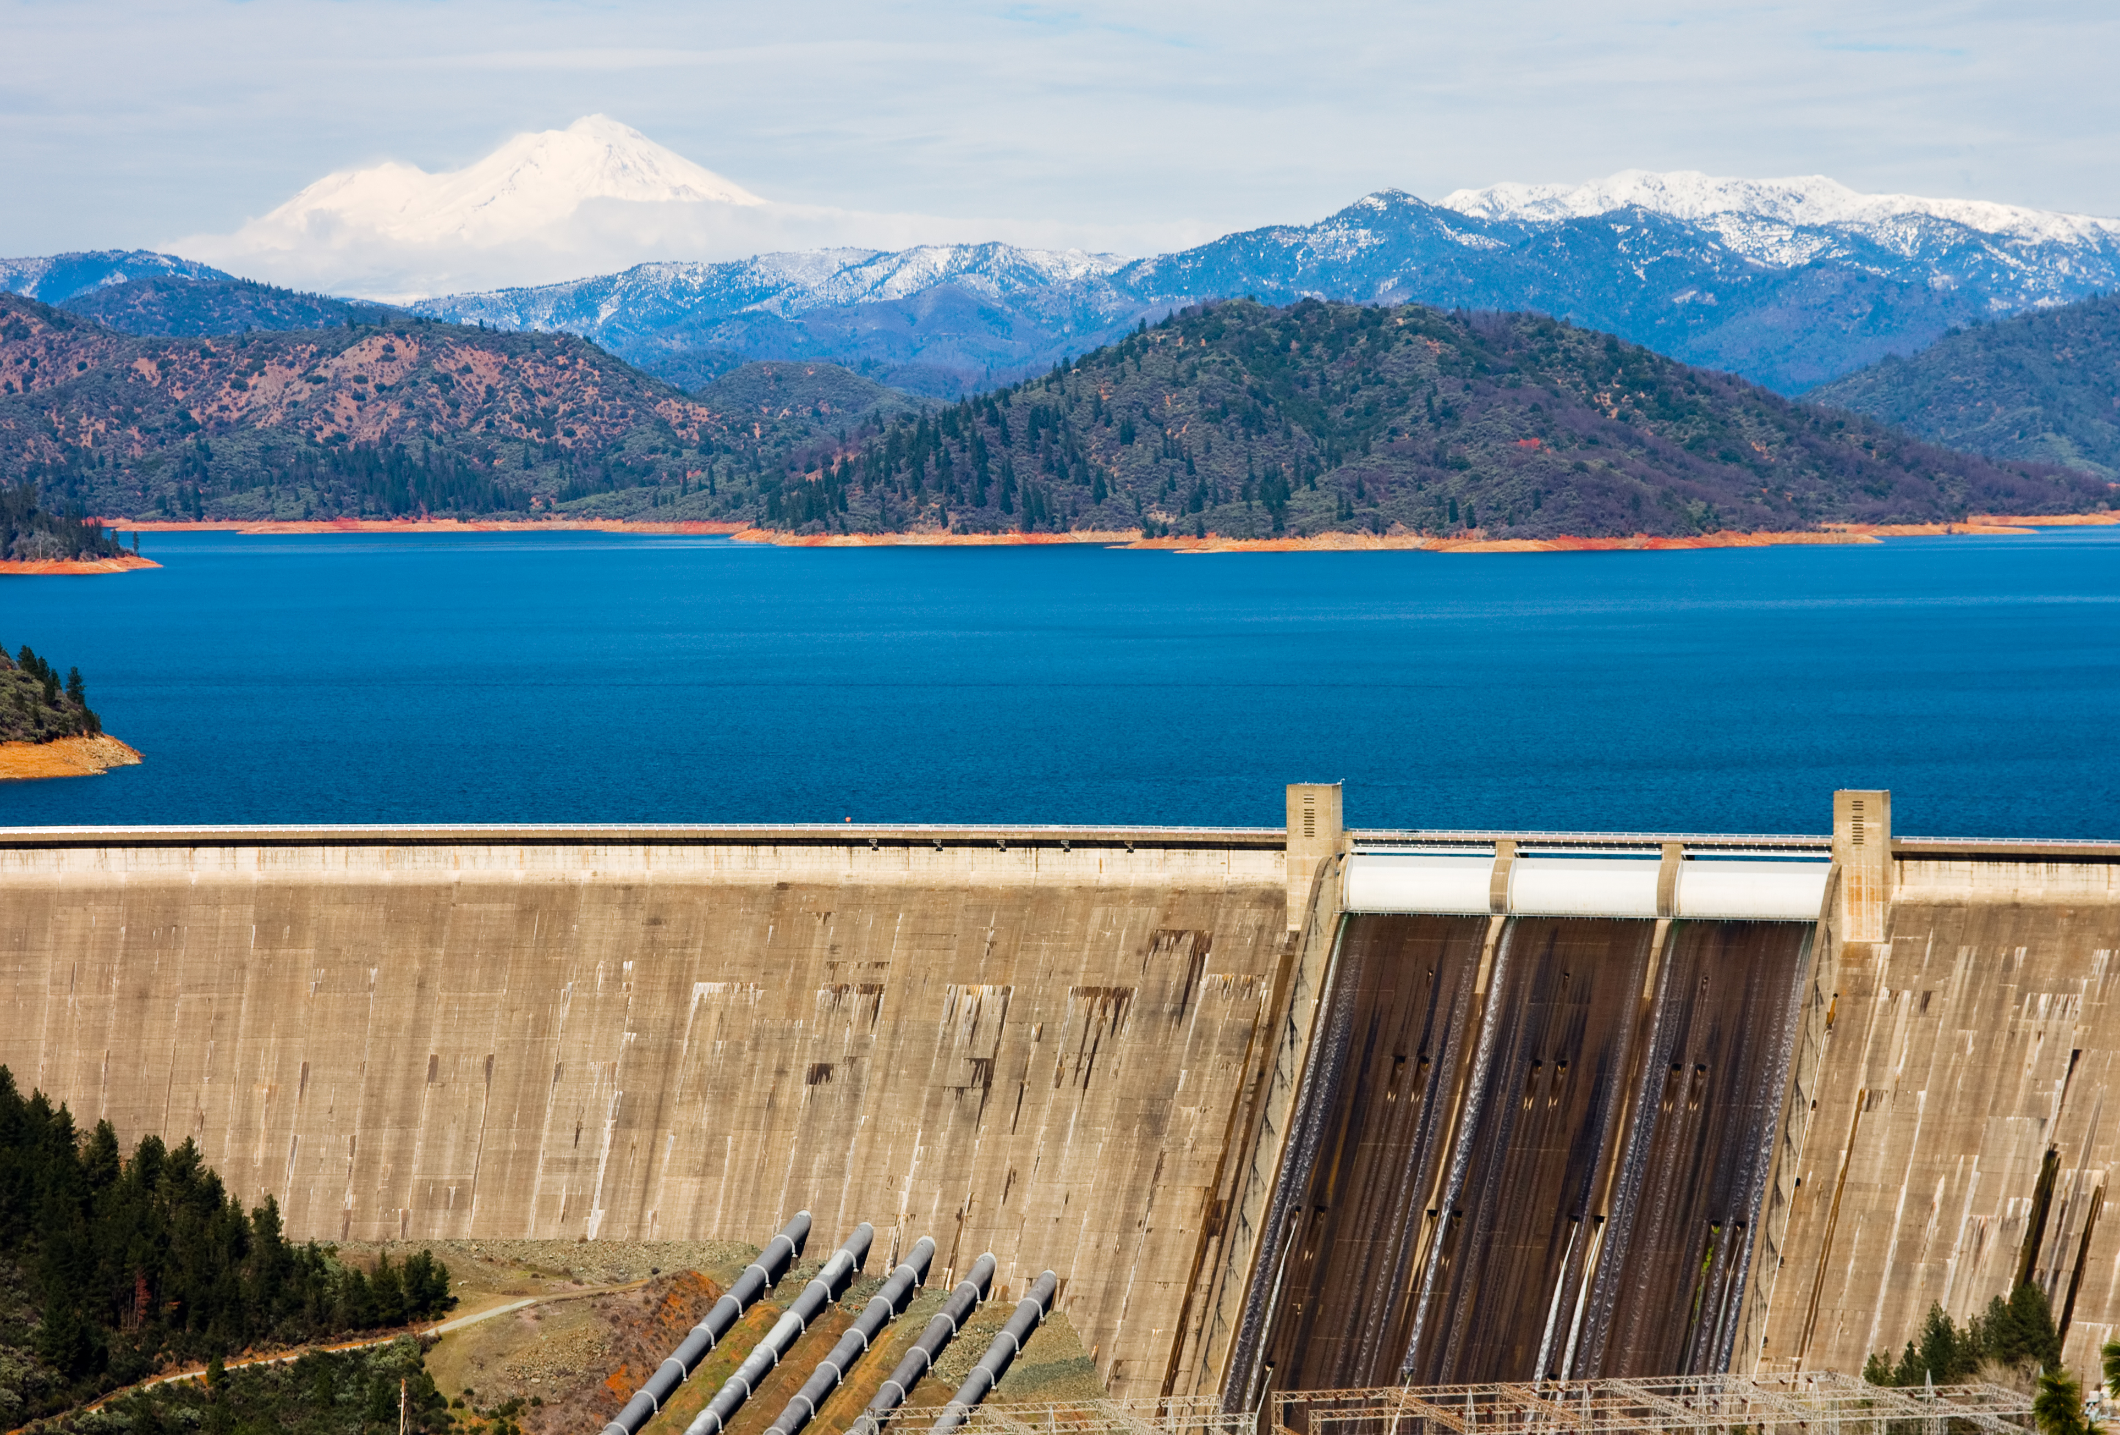
Introduction | Methods | Results | Conclusions
State Water Project
Central Valley Project
Oroville
Shasta
Capacity: 3.5 million acre-feet
Capacity: 4.5 million acre-feet
2nd Largest Reservoir
Largest Reservoir

Slide 22
Introduction | Methods | Results | Conclusions
State Water Project
Central Valley Project
Oroville
Shasta
What happens to these reservoirs under megadrought and climate change conditions?
Capacity: 3.5 million acre-feet
Capacity: 4.5 million acre-feet

Slide 23
Introduction | Methods | Results | Conclusions
Shasta
Oroville
Distribution of monthly average storages at each reservoir under megadrought conditions, across all 50 ensemble members.

Slide 24
Introduction | Methods | Results | Conclusions
Max capacity
Shasta
Oroville
Dead pool
Distribution of monthly average storages at each reservoir under megadrought conditions, across all 50 ensemble members.

Slide 25
Introduction | Methods | Results | Conclusions
Shasta
Oroville
Megadrought distribution spans dead pool to maximum capacity, with peaks at 60% and 90% capacity.

Slide 26
Introduction | Methods | Results | Conclusions
Shasta
Oroville
Shift in distributions towards lower storages and dead pool

Slide 27
Introduction | Methods | Results | Conclusions
Shasta
Oroville
Oroville is 12.5% more likely to reach dead pool than Shasta under the climate change scenario.

Slide 28
Introduction | Methods | Results | Conclusions
State Water Project
Central Valley Project
Oroville
Shasta
Sacramento-San Joaquin Delta
San Luis Reservoir
Deliveries to Districts and Groundwater Banks

Slide 29
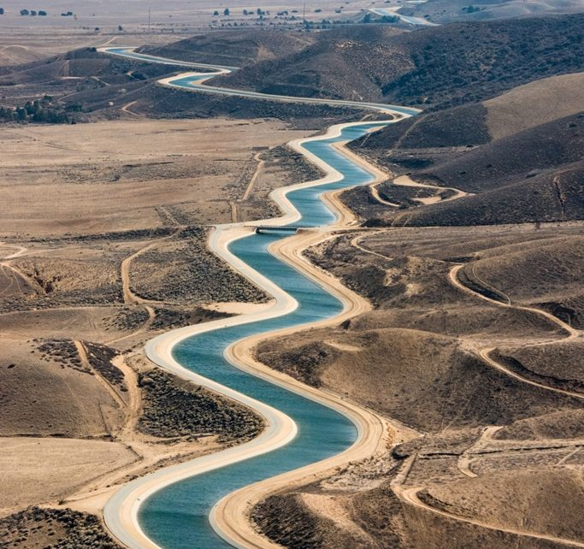
Introduction | Methods | Results | Conclusions
Water Contracts
Entitle owners to some amount of surface water that are associated with one or more reservoirs and withdrawals from canals and rivers.
State Water Project
Central Valley Project
SWP Delta
CVP Delta (Junior)
CVP Exchange
(Senior)
Source: CA DWR

Slide 30
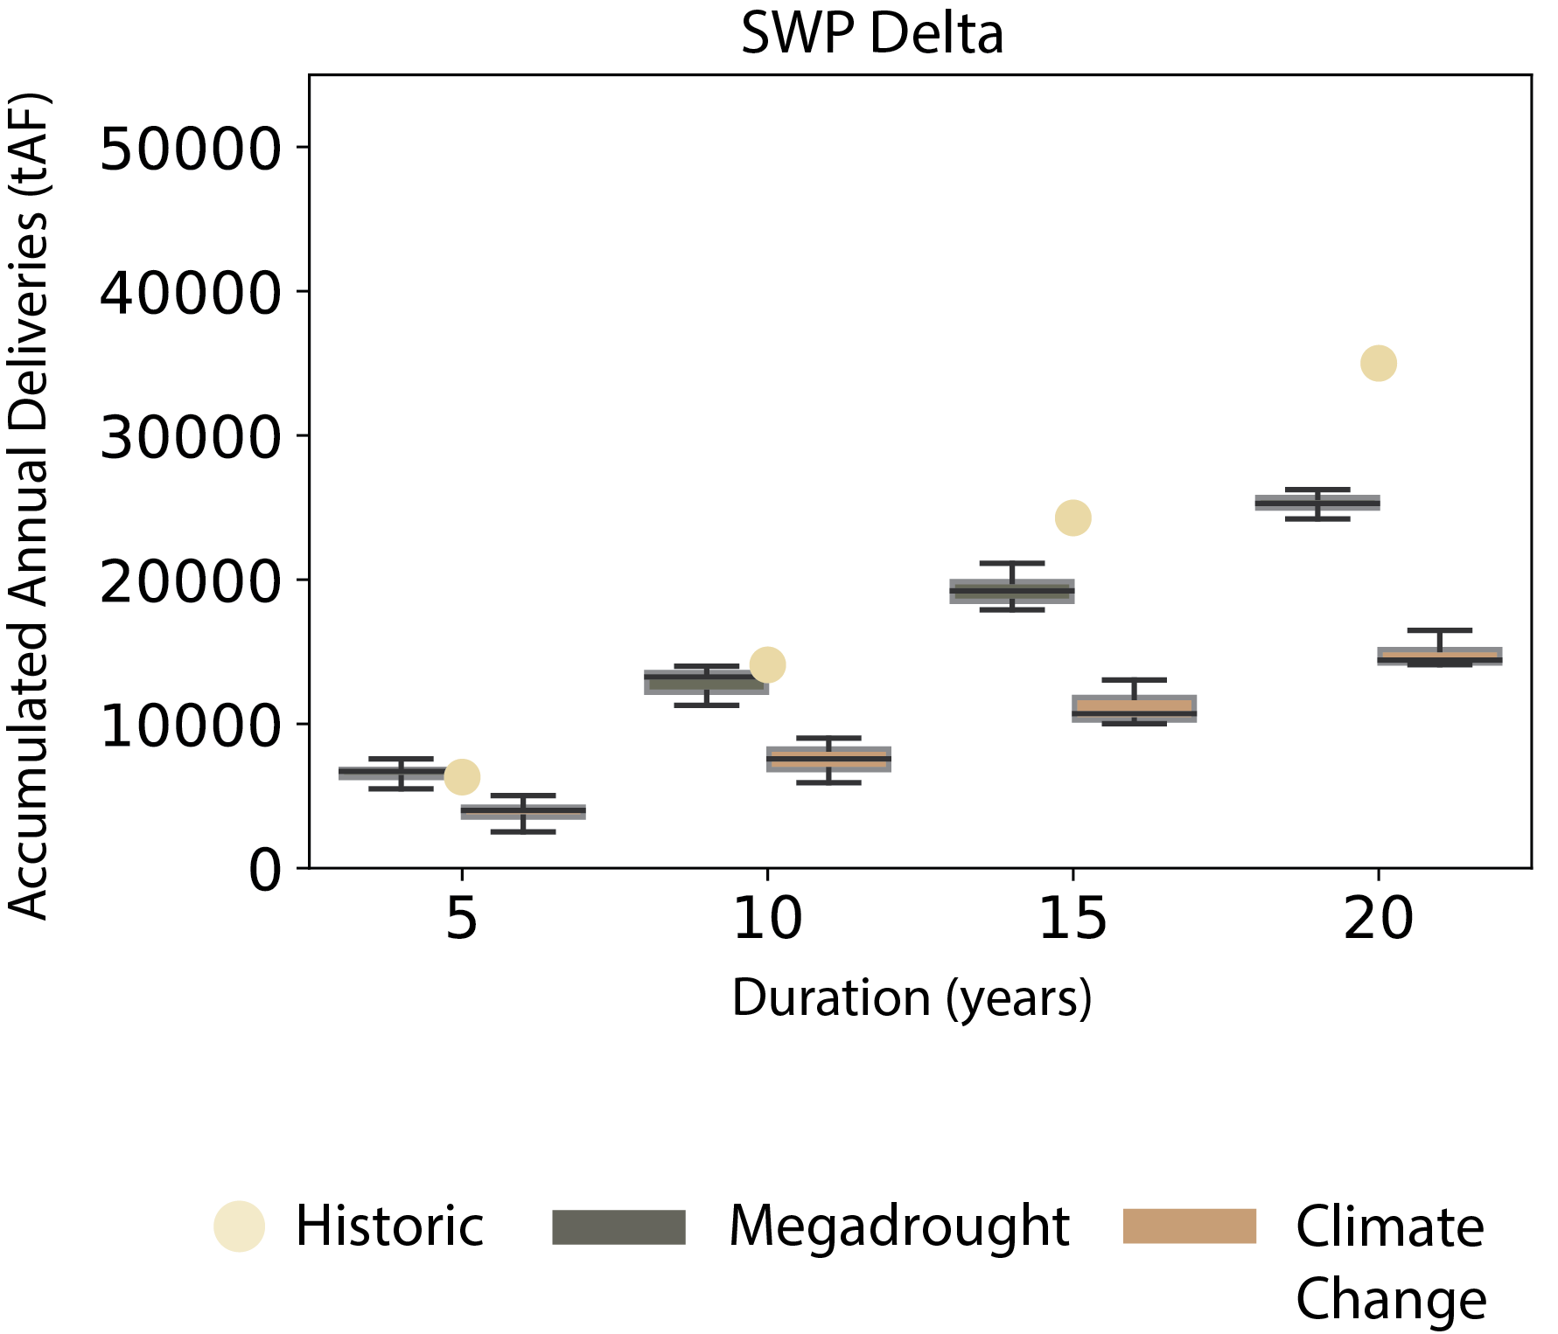
Introduction | Methods | Results | Conclusions
Minimum accumulated annual deliveries across all ensemble members and for 5, 10, 15, and 20-year durations

Slide 31
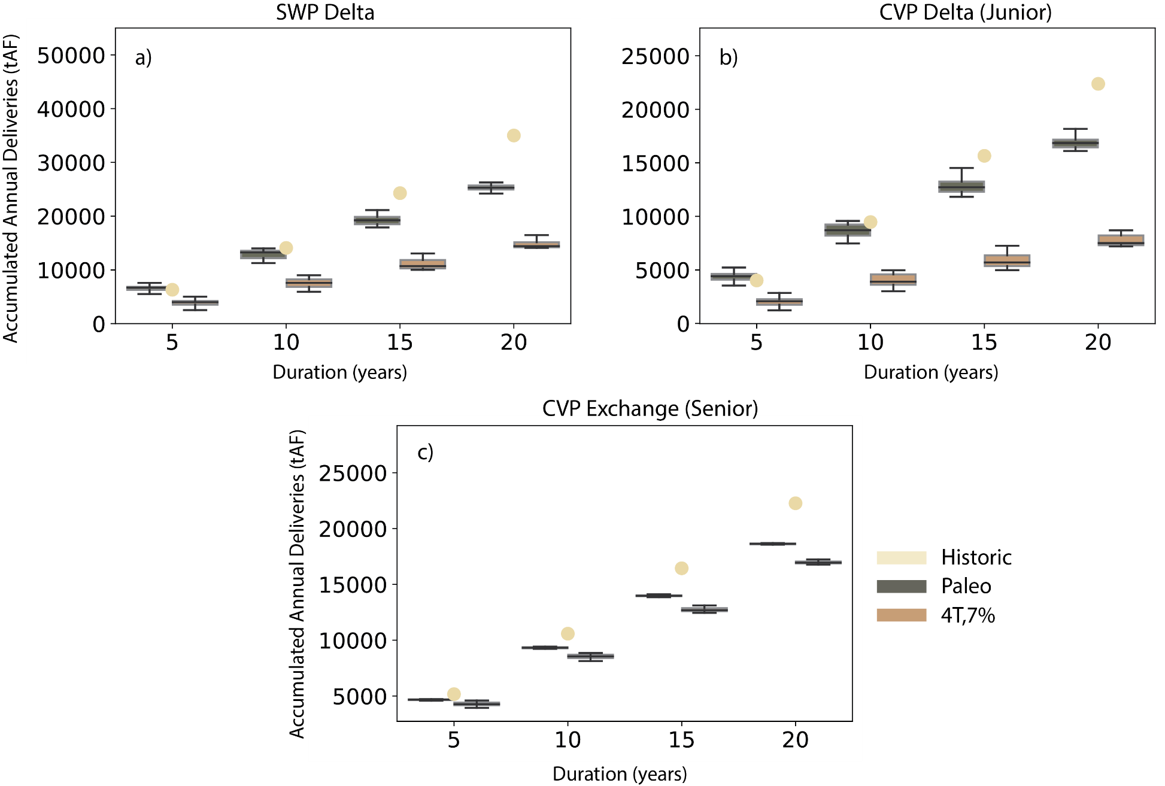
Introduction | Methods | Results | Conclusions

Slide 32
Introduction | Methods | Results | Conclusions
Over shorter time periods, users experience similar deliveries under modern and megadrought scenarios.

Slide 33
Introduction | Methods | Results | Conclusions
Under longer durations, megadrought conditions leads to accumulated deliveries that are 16-36% lower than historical.

Slide 34
Introduction | Methods | Results | Conclusions
10-year historical deliveries for SWP and CVP Delta would take 20 years to achieve under climate change conditions.

Slide 35
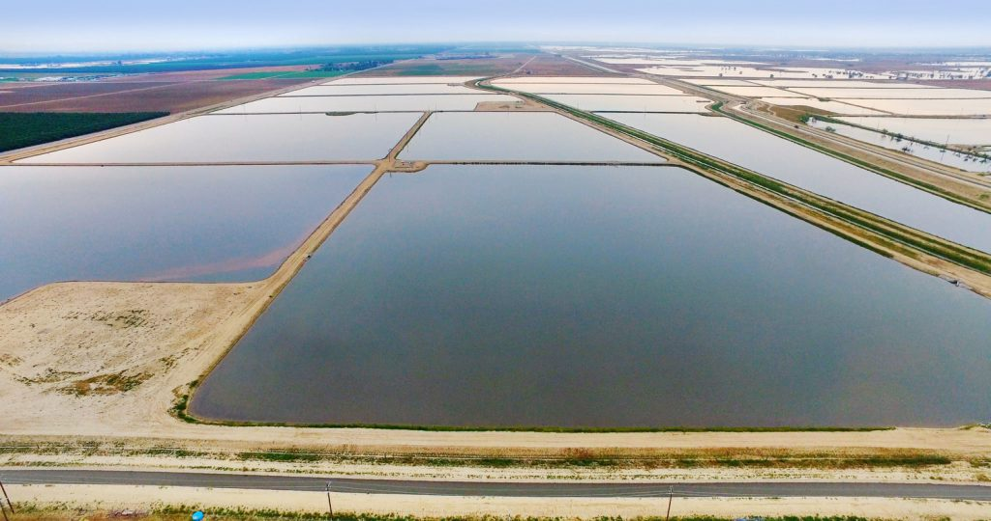
Introduction | Methods | Results | Conclusions
Kern Groundwater Bank
Capacity: 1.5 million acre-feet of water
Water is stored underground during wet years and recovered during dry years for agricultural, municipal, and industrial uses.
Source: Kern Fan Groundwater Project

Slide 36
Introduction | Methods | Results | Conclusions
Junior Account
Senior Account

Slide 37
Introduction | Methods | Results | Conclusions
Junior Account
Senior Account
Under modern conditions, senior account holder bank balance is robust.

Slide 38
Introduction | Methods | Results | Conclusions
Junior Account
Senior Account
Experiences higher frequency of depleted storages (16% under megadrought vs. 2% under historical conditions)
Experiences instances of depleted storages (0% under historical conditions)

Slide 39
Introduction | Methods | Results | Conclusions
Junior Account
Senior Account
The probability of groundwater bank balance reaching zero increases by 50% for the junior user and 120% for the senior user.

Slide 40
Key Findings
Introduction | Methods | Results | Conclusions
The Late Renaissance Megadrought is characterized by extended dry conditions that lead to increased frequency of critically low reservoir levels, multi-year periods of below normal deliveries (including to senior rights holders), and depleted groundwater resources.
1

Slide 41
Key Findings
Introduction | Methods | Results | Conclusions
The Late Renaissance Megadrought is characterized by extended dry conditions that lead to increased frequency of critically low reservoir levels, multi-year periods of below normal deliveries (including to senior rights holders), and depleted groundwater resources.
1
2
Vulnerabilities become more severe and frequent under plausible climate changes.

Slide 42
Key Findings
Introduction | Methods | Results | Conclusions
The Late Renaissance Megadrought is characterized by extended dry conditions that lead to increased frequency of critically low reservoir levels, multi-year periods of below normal deliveries (including to senior rights holders), and depleted groundwater resources.
1
2
Vulnerabilities become more severe under plausible climate changes.
3
The risk faced by stakeholders is highly dependent on their water rights, sources of water, and access to groundwater banking.

Slide 43
H51I - Water and Society: Water Resources Management and Policy in a Changing World (AGU 2024)
Thank you! Questions?
Preprint: Rohini S Gupta, Scott Steinschneider, Patrick M. Reed. Exploring Vulnerabilities in the California Water System under the Late Renaissance Megadrought and Climate Change. ESS Open Archive . October 15, 2024.
This research was sponsored by the US Department of Energy’s Office of Science as a part of the research in MultiSector Dynamics within the Earth and Environmental System Modeling program. The funding is part of the Integrated Multisector, Multiscale Modeling (IM3) Scientific Focus Area associated with Grant Number DE-AC0576RL01830.
Lake Oroville, May 2021 (source: Noah Berger / AP photo)

Slide 44
Introduction | Methods | Results | Conclusions
Average inflows decline faster at Oroville than Shasta
Difference is due to regression-based representations of seasonally varying upstream activities used to convert FNF to capture current management impacts on reservoir inflows

